Slide 1
Cycle GAN for xray
RNS INSTITUTE OF TECHNOLOGY
BENGALURU - 98
DEPARTMENT OF INFORMATION SCIENCE & ENGINEERING
Presentation on Internship
GURUPRASAD HS ADITYA D
USN: 1RN19CS053 USN: 1RN19IS011

Slide 2
AGENDA
Abstract
About the Company
Introduction
Literature Survey
Requirements
System Design
Detailed Design
Implementation
Results
Conclusion and Future Enhancements
References
Q & A

Slide 3
ABSTRACT
The novel coronavirus disease 2019 (COVID-19) is a contagious disease that has caused thousands of deaths and infected millions worldwide. Thus, various technologies that allow for the fast detection of COVID-19 infections with high accuracy can offer healthcare professionals much-needed help. This study is aimed at evaluating the effectiveness of the state-of-the-art pretrained Generative Adversial Networks (GANs) on the automatic diagnosis of COVID-19 from chest X-rays (CXRs). The dataset used in the experiments consists of 1200 CXR images from individuals with COVID-19, 1345 CXR images from individuals with viral pneumonia, and 1341 CXR images from healthy individuals. In this paper, the effectiveness of artificial intelligence (AI) in the rapid and precise identification of COVID-19 from CXR images has been explored based on different pretrained deep learning algorithms and fine-tuned to maximise detection accuracy to identify the best algorithms. The results showed that deep learning with X-ray imaging is useful in collecting critical biological markers associated with COVID-19 infections. VGG16 and MobileNet obtained the highest accuracy of 98.28%. However, VGG16 outperformed all other models in COVID-19 detection with an accuracy, F1 score, precision, specificity, and sensitivity of 98.72%, 97.59%, 96.43%, 98.70%, and 98.78%, respectively. The outstanding performance of these pretrained models can significantly improve the speed and accuracy of COVID-19 diagnosis. However, a larger dataset of COVID-19 X-ray images is required for a more accurate and reliable identification of COVID-19 infections when using deep transfer learning. This would be extremely beneficial in this pandemic when the disease burden and the need for preventive measures are in conflict with the currently available resources.

Slide 4
ABOUT THE COMPANY
NASTECH – New Age Solutions & Technologies
NASTECH is formed with the purpose of bridging the gap between Academia and Industry.
Nastech is one of the leading Global Certification and Training service providers for technical and management programs for educational institutions.
They collaborate with educational institutes to understand their requirements and form a strategy in consultation with all stakeholders to fulfill those by skilling , reskilling and upskilling the students and faculties on new age skills and technologies.
Industry and project oriented student training programs.
Certification programs mapped to Global Certification Exams from Microsoft/EC- Council/Google/AWS/ Adobe).

Slide 5
INTRODUCTION
The novel coronavirus disease 2019 (COVID-19) pandemic remains a worldwide concern, threatening to devastate global health. Early detection of infections is one of the first lines of defence against this pandemic, in a bid to reduce the spread of infections.
However, the dramatic proliferation of COVID-19 has resulted in an insufficient number of laboratory kits, creating a significant challenge . Thus, the use of radiological examinations in identifying infections has become increasingly attractive during the COVID-19 outbreak.
Particularly, as reference, a Cycle Generative Adversarial Network, often denoted as CycleGAN, was used to perform an oversampling over a chest X-ray images dataset for only the analysis of pneumonia (Malygina, Ericheva, & Drokin, 2019).
Directly related with the analysis of the COVID-19 using chest X-ray images, (Zebin, Rezvy, & Pang, 2021) proposed the use of a CycleGAN to perform an oversampling using the COVID-19 Image Data Collection dataset (Cohen et al., 2020). To this end, we combined 3 complementary CycleGAN architectures to simultaneously generate a new set of synthetic portable chest X-ray images from 3 different scenarios (normal, pathological and genuine COVID-19) without the necessity of paired data. Additionally, in order to make an exhaustive validation of the methodology, we used 4 different CycleGAN configurations (Unet with 7 downsampling blocks, denoted as Unet-128, Unet with 8 downsampling blocks, denoted as Unet-256, ResNet with 6 residual blocks, denoted as ResNet-6 and ResNet with 9 residual blocks, denoted as ResNet-9) that are tested with each scenario, thus evaluating 12 different approaches.

Slide 6
LITERATURE SURVEY
CHUAC dataset
In this work, the used dataset was obtained from the real clinical practice of a hospital in A Coruña, Galicia (Spain). Specifically, 720 chest X-ray images were retrieved from the radiology service of the Complejo Hospitalario Universitario de A Coruña (CHUAC). All the images were obtained from 2 different portable chest X-ray devices: an Agfa dr100E GE, and an Optima Rx200.
The acquisition procedure was performed with the patient in a supine position, recording a single anterior–posterior projection. In particular, the X-ray tube is connected to a flexible arm so it can be extended over the patient and, on the other side, an X-ray film holder or an image recording plate is placed under the patient to make the image capturing. This imaging was performed in medical wings that were particularly dedicated for treatment and monitoring of suspicious or diagnosed COVID-19 cases.

Slide 7
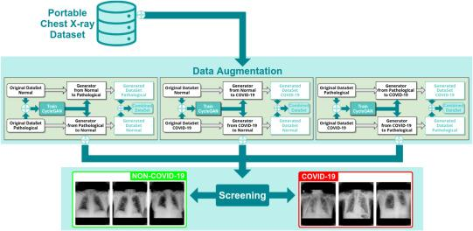
LITERATURE SURVEY
Main workflow of the proposed methodology, which is comprised of two modules: one module for simultaneous data augmentation and another responsible for the screening tasks.

Slide 8
REQUIREMENTS
HARDWARE REQUIREMENTS
Processor : Any Processor above 500 MHz
RAM : 512Mb
Hard Disk : 4 GB
Input device : Standard Keyboard and Mouse
Output device : VGA and High Resolution Monitor
SOFTWARE REQUIREMENTS
Operating system : hpos
IDE : Kaggle
Tools/Technologies : Python, Tensorflow, Keras, Nltk, LSTM, Tokenizer

Slide 9
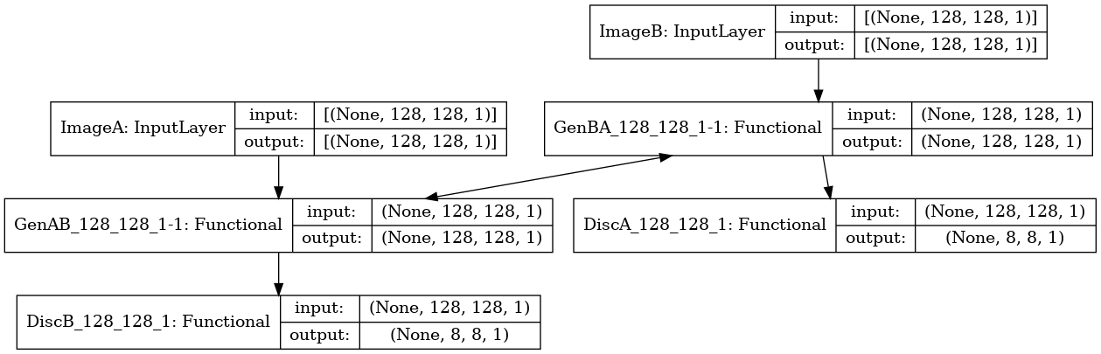
SYSTEM DESIGN

Slide 10
IMPLEMENTATION
TRAINING CODE
from IPython.display import clear_output
import scipy
from keras_contrib.layers.normalization.instancenormalization import InstanceNormalization
from keras.layers import Input, Dense, Reshape, Flatten, Dropout, Concatenate
from keras.layers import BatchNormalization, Activation, ZeroPadding2D
from keras.layers.advanced_activations import LeakyReLU
from keras.layers.convolutional import UpSampling2D, Conv2D
from keras.models import Sequential, Model
import datetime
import matplotlib.pyplot as plt
import sys
import numpy as np
import pandas as pd
from pathlib import Path
from skimage.io import imread
import os
from IPython.display import Image
from keras.utils.vis_utils import model_to_dot
from tqdm import tqdm_notebook
clear_output()
all_images_df['modality'] = all_images_df['path'].map(lambda x: x.parent.stem)
all_images_df['source'] = all_images_df['path'].map(lambda x: x.stem.split('_')[0])
all_images_df['image_id'] = all_images_df['path'].map(lambda x: '_'.join(x.stem.split('_')[1:2]))
all_images_df = all_images_df[all_images_df['modality'].isin(['masks', 'CXR_png'])]
print(all_images_df['modality'].value_counts())
all_images_df.sample(3)

Slide 11
IMPLEMENTATION
all_images_df['modality'] = all_images_df['path'].map(lambda x: x.parent.stem)
all_images_df['source'] = all_images_df['path'].map(lambda x: x.stem.split('_')[0])
all_images_df['image_id'] = all_images_df['path'].map(lambda x: '_'.join(x.stem.split('_')[1:2]))
all_images_df = all_images_df[all_images_df['modality'].isin(['masks', 'CXR_png'])]
print(all_images_df['modality'].value_counts())
all_images_df.sample(3)
fig, (a_axs, b_axs) = plt.subplots(2, 4, figsize=(20, 5))
for a_ax, b_ax, (_, c_row) in zip(a_axs, b_axs, flat_images_df.sample(20).iterrows()):
a_img = imread(c_row['CXR_png'])
a_ax.imshow(a_img)
a_ax.set_title(c_row['source'])
b_img = imread(c_row['masks'])
b_ax.imshow(b_img)

Slide 12
IMPLEMENTATION
Making inputs Case-Insensitive
To dense the multidimensional layer to linear layer
i = Input(shape=(input_shape,))
x = Embedding(vocabulary+1,10)(i)
x = LSTM(10,return_sequences=True)(x)
x = Flatten()(x)
x = Dense(output_length,activation="softmax")(x)
model = Model(i,x)
from tensorflow.keras.preprocessing.text import Tokenizer
tokenizer= Tokenizer(num_words=2000)
tokenizer.fit_on_texts(data['inputs'])
train = tokenizer.texts_to_sequences(data['inputs'])
from tensorflow.keras.preprocessing.sequence import pad_sequences
x_train=pad_sequences(train)
from sklearn.preprocessing import LabelEncoder
le = LabelEncoder()
y_train = le.fit_transform(data['tags'])

Slide 13
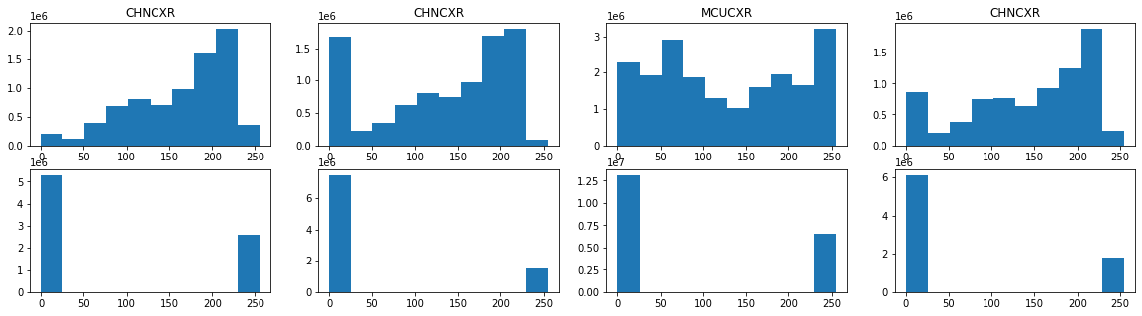
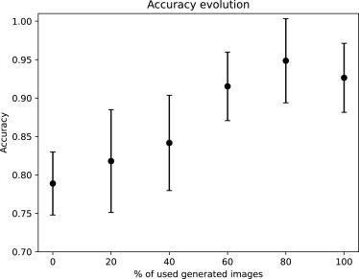
RESULTS

Slide 14
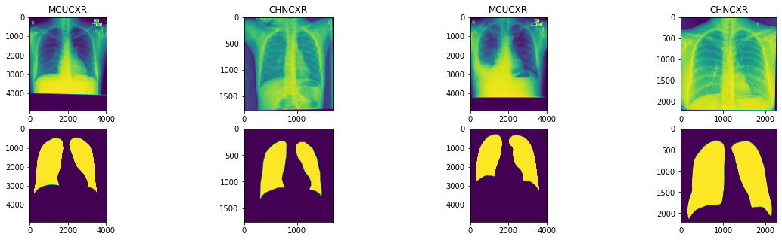
RESULTS

Slide 15
IMPLEMENTATION
Loop to predict the output based on tags
def sample_images(cyc_gan, data_loader, epoch, batch_i):
plt.close('all')
r, c = 2, 3
imgs_A = data_loader.load_data(domain="A", batch_size=1, is_testing=True)
imgs_B = data_loader.load_data(domain="B", batch_size=1, is_testing=True)
# Translate images to the other domain
fake_B = cyc_gan.g_AB.predict(imgs_A)
fake_A = cyc_gan.g_BA.predict(imgs_B)
# Translate back to original domain
reconstr_A = cyc_gan.g_BA.predict(fake_B)
reconstr_B = cyc_gan.g_AB.predict(fake_A)
gen_imgs = [imgs_A, fake_B, reconstr_A, imgs_B, fake_A, reconstr_B]
titles = ['Original', 'Translated', 'Reconstructed']
fig, axs = plt.subplots(r, c, figsize=(10, 5))
cnt = 0
for i in range(r):
for j in range(c):
c_img = np.clip(0.5 * gen_imgs[cnt][0]+0.5, 0, 1)
axs[i,j].imshow(c_img.squeeze(), cmap='gray', vmin=0, vmax=1)
axs[i, j].set_title('{} {}'.format(titles[j], 'A' if i==0 else 'B'))
axs[i,j].axis('off')
cnt += 1
fig.savefig("{:03d}_{:03d}.png".format(epoch, batch_i))
sample_images(cg, loader_obj, 0, 0)

Slide 16
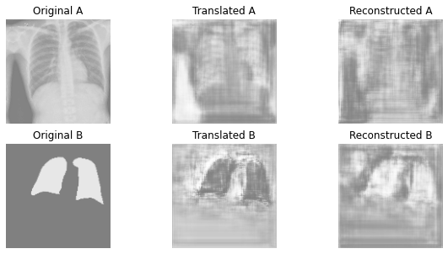
RESULTS

Slide 17
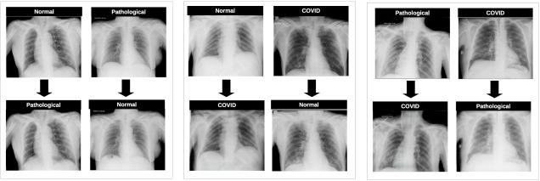
RESULTS

Slide 18
CONCLUSIONS
COVID-19 is a disease that as caused a large number of deaths worldwide,inorder to mitigate this highly infectious pulmonary disease, one of the most important challenges is the development of fast and reliable diagnostic systems, despite the lack of huge datasets given the recent appearance of the disease and the exceptional and saturated situation of the healthcare services.
In this work, we proposed an application of a CycleGAN oversampling to compensate the lack of COVID-19 portable chest X-ray samples. The considered oversampling paradigm is based on the idea of translating portable chest X-ray images from a normal scenario to a pathological one or vice versa in a fully automatic way, generating a set of useful and representative synthetic X-ray images. This set of images is then added to the original small dataset in order to increase its dimensionality in the training process. To evaluate the performance improvement that this novel set of X-ray images represents in the context of the COVID-19 screening, 5 complementary experiments were proposed, that can be divided in 3 phases.
VI Semester, Department of ISE, RNSIT

Slide 19
FUTURE ENHANCEMENTS
It should be noted that this model could be exploited in a transfer learning pipeline, using the models trained for image translation as pre-trained models for domain related applications. In the same way, the paradigm herein presented could be extrapolated to the study of other pulmonary diseases, image modalities and even other different medical domains to overcome situations of data scarcity, which is a very common and well-known issue in these particular domains and faced in many contributions.
It could be interesting to understand the impact of this idea on the performance of the image generation models. Similarly, this could also be experimented in the case of the classification architectures. In this work, we use a DenseNet architecture, while it could be interesting to understand the impact of other network architectures on the classification performance.

Slide 20
REFERENCES
[1] Anon, Classification (n.d.), Teachable
[2] Anon, Pneumonia (2019), World Health Organization
[2] B. Dadonaite, and M. Roser, Pneumonia (2019), Our World in Data
[3] C. Archie, Chest X-rays Pneumonia Detection using Convolutional Neural Network (2020), Medium.com
[4] R. Prabhu, Understanding of Convolutional Neural Network (CNN) — Deep Learning (2018), Medium.com

Slide 21
Question and Answer

Slide 22
THANK YOU

